Slide 1


Spiro Priovolos
7/14/2022

Slide 2

Outline
Executive Summary
Introduction
Methodology
Results
Conclusion
Appendix

Slide 3
Executive Summary
Winning the Space Race requires multi-dimension talents across the entire program. Engineers Engineer. Financiers Finance. Operations people manage and coordinate. And, Data Analysts contribute by helping everyone understand the determinants of Success and Failure. They help understand answers to the questions:
Why was this launch successful whereas this other one was not?
What were the key contributors to success or failure?
Where should we look to make changes?
Of course, these are not the only questions, but just a sampling. The methods we used in this analytical approach were as follows:
Data acquisition; then data cleansing; then data engineering into useful forms for analysis
Data Analysis and Exploration using ad-hoc SQL queries, data visualization using graphical objects like scatter plots, line and bar charts, confusion matrices, etc. Some of these visualizations were put into Dashboards so that they would be interactive
Building of Machine Learning models to predict successes and failures based on previous mission parameters, like: Booster Versions, Launch Sites, Payload Masses, etc..

Slide 4
Executive Summary (continued)
The results of our findings were as follows:
As one would expect, as we launched more and more missions, our success rate increased. We credit deep dives into data to achieve both large-scale and incremental improvements to our technologies and processes.
Boosters B4 and FT were our most successful, the product of improved engineering. B5 looks promising.
Our best launch site was the Kennedy Space Center, but the Cape Canaveral launch sites are very good and improving (likely in concert with engineering and process improvements). Vandenburg is capable for smaller payloads, and if it makes sense it could use investment to create more site launch flexibility.
We have great success with ES-L1, GEO, HEO, and SSO orbit types (100%); this is a viable business model
We have used Machine Learning to create an accurate model for determining success and failure based on the data we have collected. The model performed accurately 94% of the time.
Finally, while we have an accurate predictive model, our work is not complete. We recommend that further analysis takes place to understand the relative contribution of each categorical data element to success or failure. In doing so, we believe we will learn more about how each individual characteristic contributes to success.

Slide 5
Introduction
SpaceX is aggressively pursuing contributions to our global humanity by providing products and services to utilize Space outside of the Earth’s atmosphere. There is a global need for technologies to improve the human condition, like all manner of satellites and other experimental platforms.
To contribute to this mission, companies and governments need efficient and cost-effective ways to propel their satellites and platforms into orbits around the Earth. Part of the cost-effectiveness requires re-use of expensive components, like Boosters, as much as possible.
This project was undertaken by the Data Analytics team, sponsored by the Executive Team, to understand the huge volumes of data that are collected with each Launch. The objective is for the data to inform all other teams in the processes of Launch – Engineers, Ops, Finance, Marketing, etc…
We want to know answers, at least in this 1st phase of this Data Analysis project to the following questions:
(continued on next page)

Slide 6
Introduction
Why was one launch successful whereas other one was not?
What were the key contributors to success or failure?
Where should we look to make changes?
Which Customer Jobs met with Success? Which did not? Why?
Which technologies were reliable? Which were not? Why?
Can we predict Success or Failure? How well? What do we need to do to be better at prediction?

Slide 7

Section 1

Slide 8
Methodology
Executive Summary
Data collection methodology:
Data was collected using APIs from SpaceX itself as well as publish by SpaceX on a Wikipedia page. The data on Wikipedia was pulled using Web requests and parsed using the BeautifulSoup python library.
Perform data wrangling
Once data were collected, we performed some cursory tasks to understand how much data we had, which data elements were complete or sparse using counting, summary and average methods
Perform exploratory data analysis (EDA) using visualization and SQL
Perform interactive visual analytics using Folium and Plotly Dash
Perform predictive analysis using classification models

Slide 9
Data Collection – SpaceX API
Data collection was performed using REST APIs provided by SpaceX. It was performed using Python and libraries (requests, pandas, and numpy). The raw data was collected, extraneous data was filtered out, and target data was scrubbed to eliminate Null Values by replacing them with category means. The process is outlined here:
Import Request, Pandas, and Numpy Libraries
Use pre-defined functions to get data using REST api calls
Identify JSON-formatted file URL and make get request to obtain data file
Call Helper functions to get specific data from the larger data file
Create a new dataframe with the desired data, filter, and clean data
The GitHub URL of the completed SpaceX API calls notebook, as an external reference and peer-review purpose is located here:
https://github.com/aristonacademy/CourseraCapstone/blob/main/Capstone%20Project%20-%20Data%20Collection.ipynb

Slide 10
Data Collection – Scraping
Data collection was performed using Get Requests and processing data with BeautifulSoup module. The raw data was collected and BeautifulSoup was used to through the HTML, finding table headers and table row data. Table data was extracted and put into a dataframe.
Import Pandas, Request, and BeautifulSoup libraries
Identify URL to Wikipedia SpaceX launch data tables, use GET request to pull data
Using BeautifulSoup, identify HTML tables, iterate through to find Table Headers and Table Data
Upon finding Table Headers and Table Data, extract them and form a new dataframe
The GitHub URL of the completed SpaceX web scraping notebook, as an external reference and peer-review purpose is located here:
https://github.com/aristonacademy/CourseraCapstone/blob/main/Capstone%20Project%20-%20Web%20Scraping%20w/%20BSoup.ipynb

Slide 11
Data Wrangling
SpaceX data set is loaded from CSV file stored on IBM servers in the cloud. Following, Exploratory analysis is performed on key data columns to determine if there are Nulls; also grouping data by categorical columns using value_counts() to understand the data.
Import Libraries
Pull CSV file from the Cloud
Use isnull() and count() and groupby() and value_counts() to understand data by categories like Outcomes and Orbits
Identify Successful and Unsuccessful launch outcomes and then use to create a ‘class’ categorical value for success or failure; save data set
The GitHub URL of the completed SpaceX data wrangling notebook, as an external reference and peer-review purpose is located here:
https://github.com/aristonacademy/CourseraCapstone/blob/main/Capstone%20Project%20-%20Data%20Wrangling.ipynb

Slide 12
EDA with Data Visualization
In Visualizing the SpaceX launch data, I wanted to get a feel how Launch Sites, Orbits, Payload Mass, and Time/Year related to one another.
This was done by creating the following scatterplots:
Flight Number (which sequentially/chronologically orders events) and Payload Mass. This showed Success or Failure for each combination of Flight Number and Payload Mass. Over time, there was improvement in Successes.
Flight Number vs. Launch Site. This showed Success or Failure for each Launch Site over time. For 2/3 of the Launch Sites, Success rate increased, while for the 3rd Success and Failure wasn’t noticeably improved.
Flight Number vs. Orbit Type. This showed Success or Failure for each Orbit Type over time. From this graph you get a sense of which orbit types were the most used. Pretty much all orbit types got more successful over time.
Payload Mass vs. Orbit Type. This showed that at payloads of 6000kg or lower, there were many successes and a few failures (though some orbit types were all successful), but at payloads above 6000kg the ISS, PO, and VLEO orbits were used and almost all successful.
In addition to scatterplots, there was a line chart showing Success Rate by Year. In this chart you can see that success rates improved from 2013 to 2020 with a slight downward move from 2018 to 2019.
The GitHub URL of the completed Data Visualization notebook, as an external reference and peer-review purpose is located here:
https://github.com/aristonacademy/CourseraCapstone/blob/main/Capstone%20Project%20-%20Data%20Wrangling.ipynb

Slide 13
EDA with SQL
Exploratory Data Analysis was also performed using SQL queries to summarize data points of interest. Before running any queries, some of the data set’s columns were ‘cleansed’ to be in the correct formats. The following represents the types of queries performed and their summary findings (in no particular order):
Summary queries of Payload Mass data by Customer (e.g. NASA) to understand Total/Sum of mass launched on behalf of that customer across all launches
Summary query of Payload Mass by Launch Site, to understand the Average mass launched from that site. From this we can see if there seems to be differences between launch sites in terms of what is launched
Query to find the first date for a Successful launch
Query to see the number of Outcomes that correspond to Success or Failure of a Mission
Query to see the Booster Version that has carried the Largest Payload Mass
Query to see the Booster Version and Launch Sites associated with Failure to land on a Drone Ship in the calendar year 2015
Query to see All the Landing Outcomes and their Count during a specified Start Date/End Date period
These queries allow us to get a sense of what our data looks like and where we may wish to probe for further understanding and learning.
Using bullet point format, summarize the SQL queries you performed
Add the GitHub URL of your completed EDA with SQL notebook, as an external reference and peer-review purpose
The GitHub URL of the completed EDA with SQL notebook, as an external reference and peer-review purpose is located here:
https://github.com/aristonacademy/CourseraCapstone/blob/main/Capstone%20Project%20-%20Exploratory%20Data%20Analysis.ipynb

Slide 14
Build an Interactive Map with Folium
Using the Folium library and the data set, which included Latitude and Longitude coordinates for each Launch Site, I was able to map the Launch Sites, Cluster Successes and Failures, Color Successes as Green circles within map markers and Red circles within map markers for Failures, Calculate and Plot lines to key points like Coastlines and Railways.
These maps features were placed so that an analyst can easily see the Launch Sites and key information about them, including:
Location of Launch Site,
Number of Launches from the Site
Number of Successes and Failures
Distance of Launch Site to key geographic features like coastlines, railways, highways, and city centers.
These features are important in that they show directionally where a drone ship may have to be in order to receive a Booster. Also, how much room for error and safety considerations for people populations.
The GitHub URL of the completed EDA with SQL notebook, as an external reference and peer-review purpose is located here:
https://github.com/aristonacademy/CourseraCapstone/blob/main/Capstone%20Project%20-%20Data%20Vis%20w%20Folium.ipynb

Slide 15
Build a Dashboard with Plotly Dash
I built an Interactive Dashboard application using Dash. Dash libraries allow you to build very interactive Visualizations using Dropdown selectors, Range Sliders, Checklists, et. al.
The Dashboard I build had two graphs:
A Pie Chart that showed the Percentage of Successful Launches for each Site if ‘ALL’ sites was selected, and If only a specific Launch Site was selected, the Percentage of Success vs. Failure for that specific site. The Launch Site was selected using a Dropdown List and the chart updates based on the selected value.
A Scatter Plot that showed Success or Failure vs. Payload Mass for each Booster Version. Successes correspond to ‘class’ variable = 1 and Failures correspond to ‘class’ variable = 0. Each Booster Version is a color coded dot in the graph. The Scatter Plot’s Payload Mass range can be changed by using a Range Slider.
The Pie Chart allows us to see, at a glance, which Launch Sites have contributed to the most and least successful launches. We can then drill-down into a particular site to see how successful each site is on its own.
The Scatter Plot allows us to analyze successes and failures and see how each booster version performs at different levels of payload mass.
The GitHub URL of the completed EDA with SQL notebook, as an external reference and peer-review purpose is located here: https://github.com/aristonacademy/CourseraCapstone/blob/main/spacex_dash_app%20(1).py

Slide 16
Predictive Analysis (Classification) – Data Processing
The SpaceX data set was used for this analysis. However, the data, while rich in content, is not in a format conducive to use in Machine Learning algorithms.
The data required some Feature Engineering to take the data in categorical data columns and expand it into its own columns, with 0s and 1s
The data, after it was Feature Engineered, was assigned to the X variable (independent variable)
The Y value was based on the ‘class’ column, as it was the result of Success or Failure
The data was also standardized using StandardScaler() and re-assigned to X
I then use train_test_split() to create a training and testing data set (80% training, 20% test)
At this point, the data was not in a form that could be used to train and test the four different classification algorithms (Logistic regression, SVM, Decision Tree, and K Nearest Neighbor)

Slide 17
Predictive Analysis (Classification) – Models/Algorithms
All of the Model algorithms utilized used a very similar process:
Perform Grid Search using GridSearchCV() utilizing hyperparameters that are specific to each algorithm; Grid Search find the optimal combination of hyperparameters for the specific algorithm; for example, for Logistic Regression the best hyperparameters were: {'C': 0.01, 'penalty': 'l2', 'solver': 'lbfgs’}
Fit each Model using the optimal hyperparameters and training data set
Print out the accuracy for each Model using the best_score_ attribute that resulted from Model fitting
Calculate Model accuracy using the score() method and the test data
Graph Confusion Matrix
Logistic Regression Results
Optimal hyperparameters were: {'C': 0.01, 'penalty': 'l2', 'solver': 'lbfgs’}
Model Fit Accuracy was 0.846; Prediction Accuracy score was 0.833
The Confusion Matrix showed some false positives; There were 6 “did not land” in the data, but 3 of those were characterized as having “landed”

Slide 18
Predictive Analysis (Classification) – Models/Algorithms
Support Vector Machine Results (SVM)
Optimal hyperparameters were: {'C': 1.0, 'gamma': 0.03162277660168379, 'kernel': 'sigmoid’}
Model Fit Accuracy was 0.848; Prediction Accuracy score was 0.833
The Confusion Matrix showed some false positives; There were 6 “did not land” in the data, but 3 of those were characterized as having “landed”
Decision Trees Results
Optimal hyperparameters were: {'criterion': 'gini', 'max_depth': 10, 'max_features': 'auto', 'min_samples_leaf': 4, 'min_samples_split': 5, 'splitter': 'best’}
Model Fit Accuracy was 0.90; Prediction Accuracy score was 0.944
The Confusion Matrix showed minimal false positives; There were 6 “did not land” in the data, and only 1 of those were characterized as having “landed”

Slide 19
Predictive Analysis (Classification) – Models/Algorithms
K-Nearest Neighbors Results
Optimal hyperparameters were: {'algorithm': 'auto', 'n_neighbors': 10, 'p': 1}
Model Fit Accuracy was 0.848; Prediction Accuracy score was 0.833
The Confusion Matrix showed some false positives; There were 6 “did not land” in the data, but 3 of those were characterized as having “landed”
Results
The Decision Tree Model outperformed the other models, having the best accuracy on both the training data set and the test data set. The Confusion Matrix for Decision Tree showed that it performed well on predicting actual “Landings” and also predicting “Non-Landings”.

Slide 20
Results
Exploratory data analysis results
Interactive analytics demo in screenshots
Predictive analysis results

Slide 21

Section 2

Slide 22
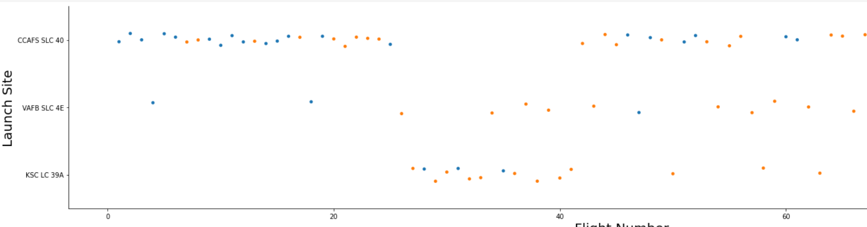
Flight Number vs. Launch Site
This scatterplot show the relationship between Flight Number (x-axis) and Launch Site (y-axis). Each point shows Successful Launches (Orange dots) vs. Unsuccessful Launches (Blue dots).
This show several outcomes: 1) Up until approximately the 20th launch, most of the launches were unsuccessful, regardless of the launch site, 2) After the 20th launch, most of the launches were seeing success, and more of the Launch Sites were utilized

Slide 23
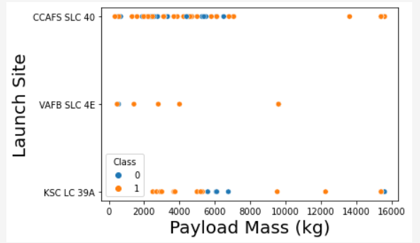
Payload vs. Launch Site
This chart shows Payload Mass vs. Launch Site
The findings are as follows: 1) The most utilized Launch Sites are CCAFS SLC 40 and KSC LC 39A, 2) VAFB SLC 4E did not launch any payloads greater than 10000kg

Slide 24
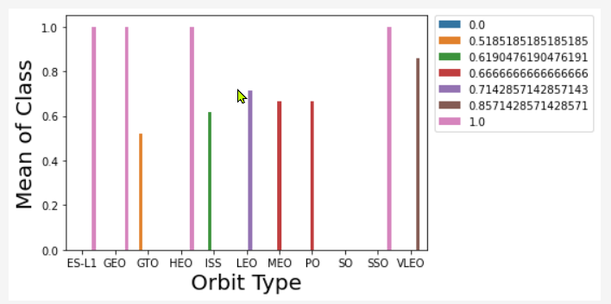
Success Rate vs. Orbit Type
This shows the success rates (y-axis) of each Type of Orbit (x-axis)
It is clear that ES-L1, GEO, HEO, and SSO orbit types are 100% successful.
VLEO and LEO are also more than 70% successful.

Slide 25
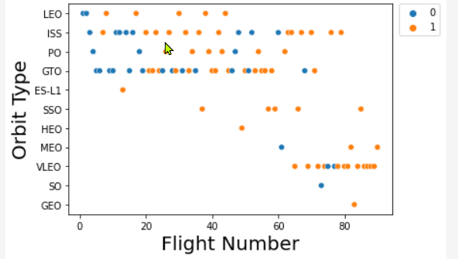
Flight Number vs. Orbit Type
This shows Flight Number (x-axis) vs. Orbit Type (y-axis). Blue dots represent failure and Orange dots represent success.
We can see that in the early days of launches, most of the orbit types were LEO, ISS, PO, and GTO. There were also a large percentage of failures at this stage. After about the 20th launch, there was a higher percentage of successes and more Orbit types were attempted (mostly successfully).

Slide 26
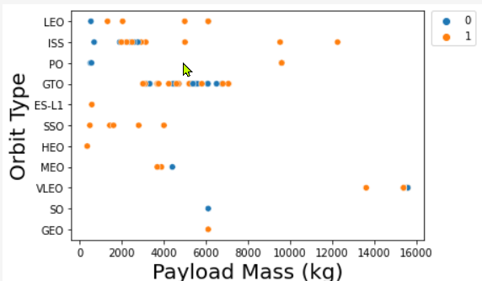
Payload vs. Orbit Type
This represents the relationship between Payload Mass (x-axis) and Orbit type y-axis), with blue dots representing failures and orange dots representing successes.
You can see that for payload mass below 6000kg, there are mostly successes (with a few failures, primarily from the early days of operation); beyond 6000kg, most of the larger payloads are associated with ISS, PO and VLEO orbit types.

Slide 27
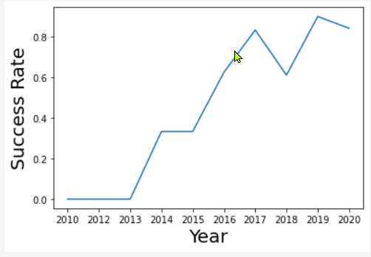
Launch Success Yearly Trend
This graph shows the trend of the success rate from beginning of operations in 2010 until 2020.
As you might expect, in the early days, there were many failures, but starting 2013, success rate increased steadily until 2020. There were a couple of years where a few failures increased, but they were associated with new orbit types and approaches. This can be expected when you expand operations.

Slide 28
All Launch Site Names
The following query was run against the database table loaded from the SpaceX data set:
%sql select distinct launch_site from spacextbl
Producing the following results
The SQL selects the names of the Launch Sites, filtering out duplicates and producing only the unique names
launch_site
CCAFS LC-40
CCAFS SLC-40
KSC LC-39A
VAFB SLC-4E

Slide 29
Launch Site Names Begin with 'CCA'
Find 5 records where launch sites begin with `CCA`
This was produced by the following SQL
%sql select * from spacextbl where launch_site like 'CCA%' limit 5
DATE | time__utc_ | booster_version | launch_site | payload | payload_mass__kg_ | orbit | customer | mission_outcome | landing__outcome
2010-06-04 | 18:45:00 | F9 v1.0 B0003 | CCAFS LC-40 | Dragon Spacecraft Qualification Unit | 0 | LEO | SpaceX | Success | Failure (parachute)
2010-12-08 | 15:43:00 | F9 v1.0 B0004 | CCAFS LC-40 | Dragon demo flight C1, two CubeSats, barrel of Brouere cheese | 0 | LEO (ISS) | NASA (COTS) NRO | Success | Failure (parachute)
2012-05-22 | 07:44:00 | F9 v1.0 B0005 | CCAFS LC-40 | Dragon demo flight C2 | 525 | LEO (ISS) | NASA (COTS) | Success | No attempt
2012-10-08 | 00:35:00 | F9 v1.0 B0006 | CCAFS LC-40 | SpaceX CRS-1 | 500 | LEO (ISS) | NASA (CRS) | Success | No attempt
2013-03-01 | 15:10:00 | F9 v1.0 B0007 | CCAFS LC-40 | SpaceX CRS-2 | 677 | LEO (ISS) | NASA (CRS) | Success | No attempt

Slide 30
Total Payload Mass
Calculate the total payload carried by boosters from NASA
The total payload was: 48213 kg
The query used to produce this was:
%sql select sum(payload_mass__kg_) from spacextbl where customer like 'NASA%CRS%’
This query SUMS the column payload_mass__kg for all rows where the customer name field begins with the letter sequence ‘NASA’

Slide 31
Average Payload Mass by F9 v1.1
The average payload mass carried by booster version F9 v1.1 was 2928 kg
The query used to calculate Average Payload Mass for the F9 v1.1 Booster was:
%sql select avg(payload_mass__kg_) from spacextbl where booster_version = 'F9 v1.1’
The query uses the SQL ‘avg’ function on the payload_mass_kg column for all rows where the booster_version column is ‘F9 v1.1’
The average payload mass for this Booster Version is on the lower-end of the payloads launched over all the launches by SpaceX

Slide 32
First Successful Ground Landing Date
The date of the first successful landing outcome on ground pad was December 22, 2015
The query used was:
%sql select min(date) from spacextbl where landing__outcome = 'Success (ground pad)’
The query uses the ‘min’ function on the date column to find the earliest date where the rows correspond to a ‘landing_outcome’ column that is “Success (ground pad)”

Slide 33
Successful Drone Ship Landing with Payload between 4000 and 6000
The names of boosters which have successfully landed on drone ship and had payload mass greater than 4000 but less than 6000 are:
The query used to retrieve these booster versions was:
%sql select booster_version from spacextbl where (payload_mass__kg_ between 4000 and 6000) and landing__outcome = 'Success (drone ship)'
booster_version
F9 FT B1022
F9 FT B1026
F9 FT B1021.2
F9 FT B1031.2

Slide 34
Total Number of Successful and Failure Mission Outcomes
The total number of successful and failure mission outcomes is as follows:
The query used to determine the number of mission outcomes that were successful or failures was:
%sql select mission_outcome, count(mission_outcome) as total from spacextbl group by mission_outcome
Note: There is a difference between mission success/failure and whether there was success/failure in retrieving used Boosters.
mission_outcome | total
Failure (in flight) | 1
Success | 99
Success (payload status unclear) | 1

Slide 35
Boosters Carried Maximum Payload
The names of the booster which have carried the maximum payload mass are:
booster_version | payload_mass__kg_
F9 B5 B1048.4 | 15600
F9 B5 B1049.4 | 15600
F9 B5 B1051.3 | 15600
F9 B5 B1056.4 | 15600
F9 B5 B1048.5 | 15600
F9 B5 B1051.4 | 15600
F9 B5 B1049.5 | 15600
F9 B5 B1060.2 | 15600
F9 B5 B1058.3 | 15600
F9 B5 B1051.6 | 15600
F9 B5 B1060.3 | 15600
F9 B5 B1049.7 | 15600
The query used to determine the boosters carrying the maximum payload mass was:
%sql select booster_version, payload_mass__kg_ from spacextbl where payload_mass__kg_ = (select max(payload_mass__kg_) from spacextbl)
The query selects the booster_version and payload_mass_kg columns that correspond to a payload_mass_kg that matches the result received from a subquery that finds the maximum payload mass carried

Slide 36
2015 Launch Records
The failed landing_outcomes in drone ship, their booster versions, and launch site names for year 2015 are:
The query used to produce the results was:
%sql select landing__outcome, booster_version, launch_site from spacextbl where landing__outcome = 'Failure (drone ship)' and Date like '2015%’
The query selects the three columns corresponding to the requirements and chooses only the rows corresponding to a landing outcome of ‘Failure (drone ship)’ and a data that has ‘2015’ as the year.
landing__outcome | booster_version | launch_site
Failure (drone ship) | F9 v1.1 B1012 | CCAFS LC-40
Failure (drone ship) | F9 v1.1 B1015 | CCAFS LC-40

Slide 37
Rank Landing Outcomes Between 2010-06-04 and 2017-03-20
Rank the count of landing outcomes (such as Failure (drone ship) or Success (ground pad)) between the date 2010-06-04 and 2017-03-20, in descending order
landing__outcome | total
No attempt | 10
Failure (drone ship) | 5
Success (drone ship) | 5
Controlled (ocean) | 3
Success (ground pad) | 3
Failure (parachute) | 2
Uncontrolled (ocean) | 2
Precluded (drone ship) | 1
The query used to generate the results was:
%sql select landing__outcome, count(landing__outcome)
as total from spacextbl
where Date between '2010-06-04' and '2017-03-20’
group by landing__outcome
order by total desc
The query selects the landing_outcome column and selects all the rows that correspond to dates between June 4, 2010 and March 20, 2017. It then counts the number of rows that are grouped by the landing_outcome column.

Slide 38

Section 3

Slide 39
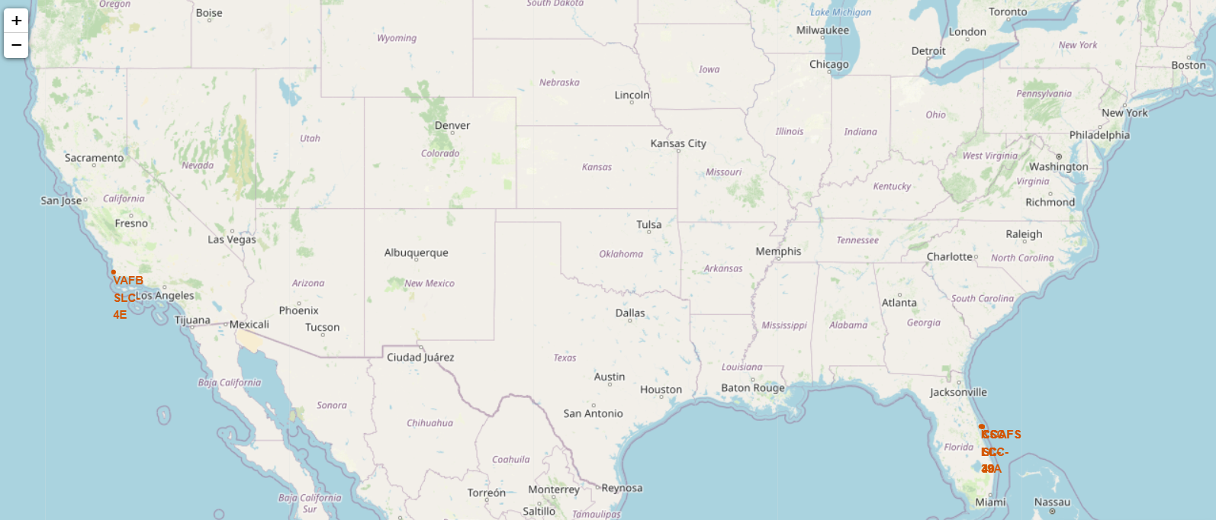
Locations of SpaceX Launch Site
The map above was created using the Folium library. On this particular map view, you can see the markers for the Launch Sites. One of these is Vandenburg Air Force base in California. Three others are in Florida: Kennedy Space Center (KSC) and two nearby at Cape Canaveral (CCAFS LC40 and CCAFS SLC-40). In the upper left, you can use controls to zoom in or zoom out.

Slide 40
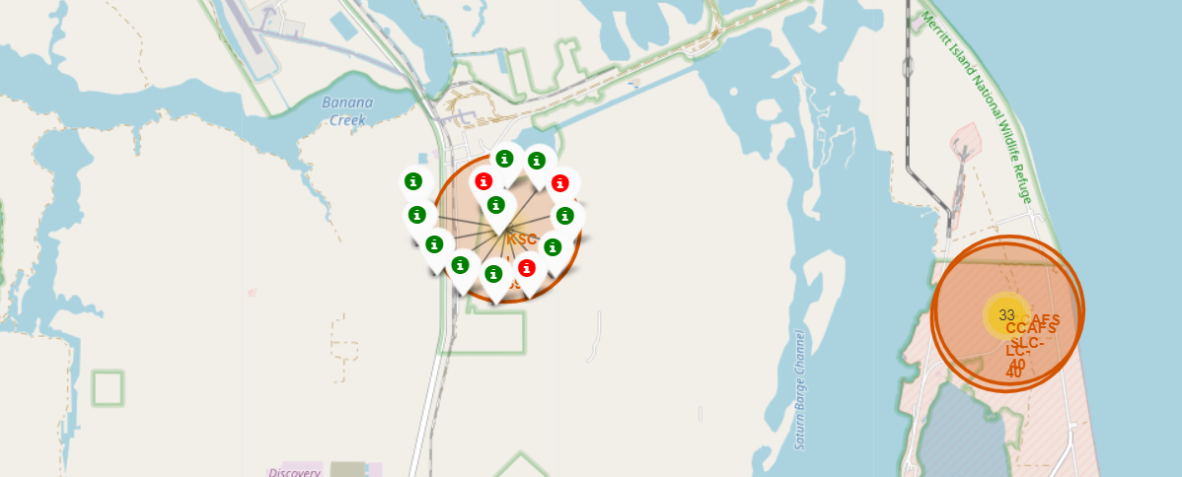
Launch Site – Successes and Failures
This map shows Launch Outcomes for the Kennedy Space Center launch site. The green markers indicate successes and the red markers indicate failures. You can also see:
The two other launch sites in Florida (on the right). If we were to drill-down on those, we would also be able to see the Launch Outcomes for those site.
As you can see, there were 10 successes and 3 failures at KSC.

Slide 41
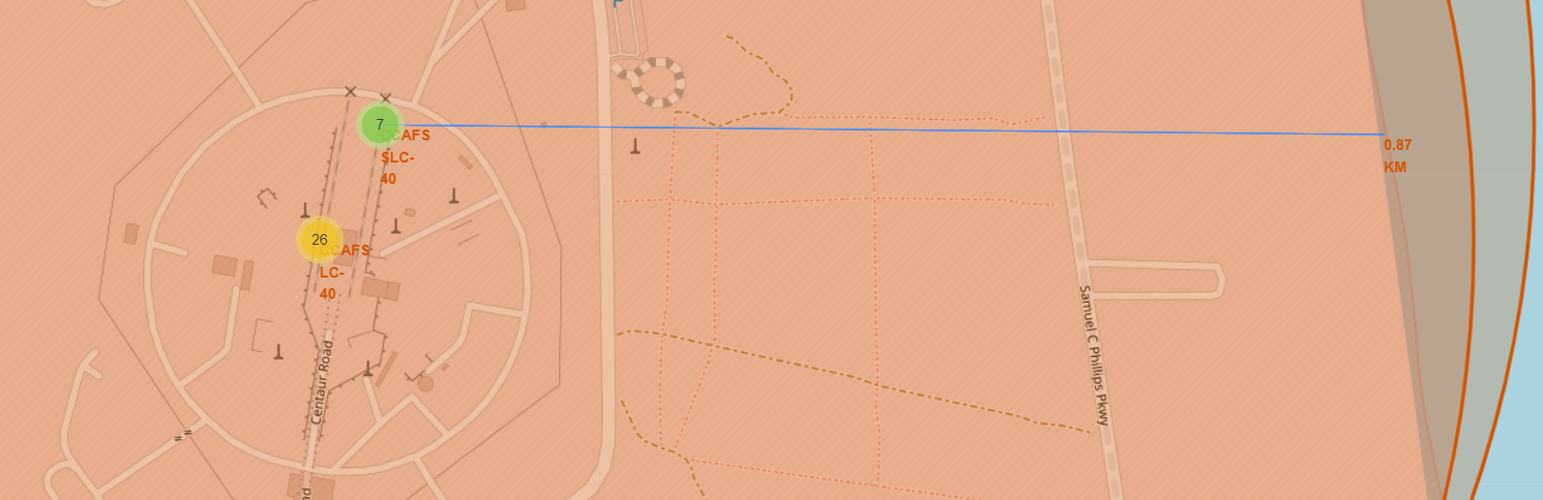
Map of CCAFS SLC40 Distance to Coastline
This maps shows both Cape Canaveral launch sites and it shows the closest distance to the coastline of Florida. It shows that the distance is approximately 0.87 KM (as annotated)
Similar annotations using lines and distance markers can be constructed to other important topological features, like railways and major highways.

Slide 42

Section 4

Slide 43
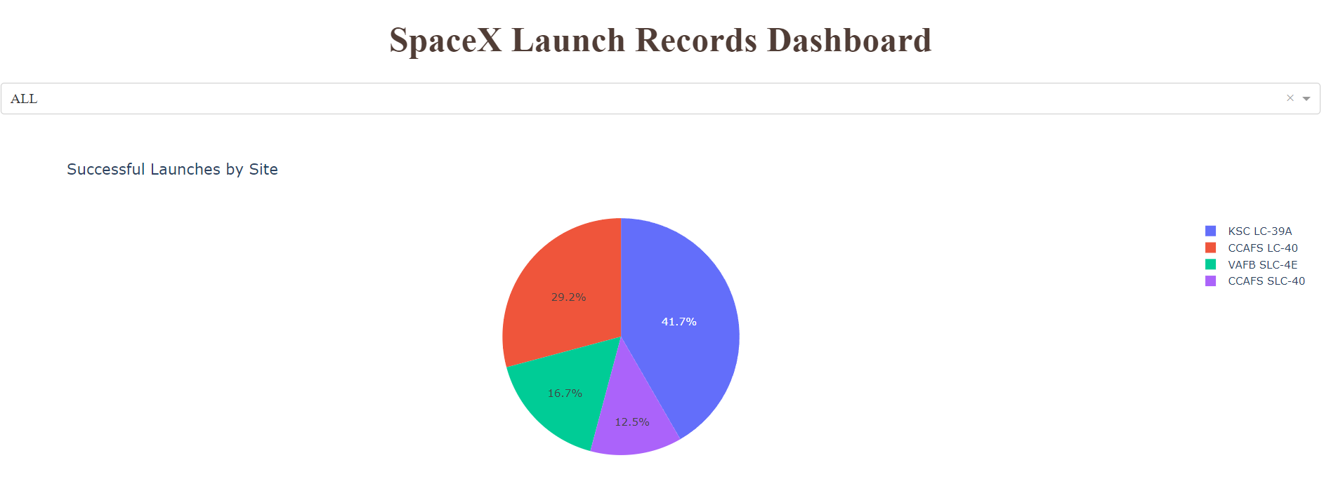
SpaceX Dash Application – Pie Chart – ALL Sites
This is a screenshot of the landing page of the SpaceX Dash application.
Upon start-up, the user is shown a pie chart that breaks down Successful launches (in %) for each launch site. The Dropdown allows the user to select “ALL” or to select an individual site. If the user chooses and individual site, then it will show a pie chart of % Success vs. % Failure.
Also on this pie chart is a Title (on the left) and a Legend (on the right)

Slide 44
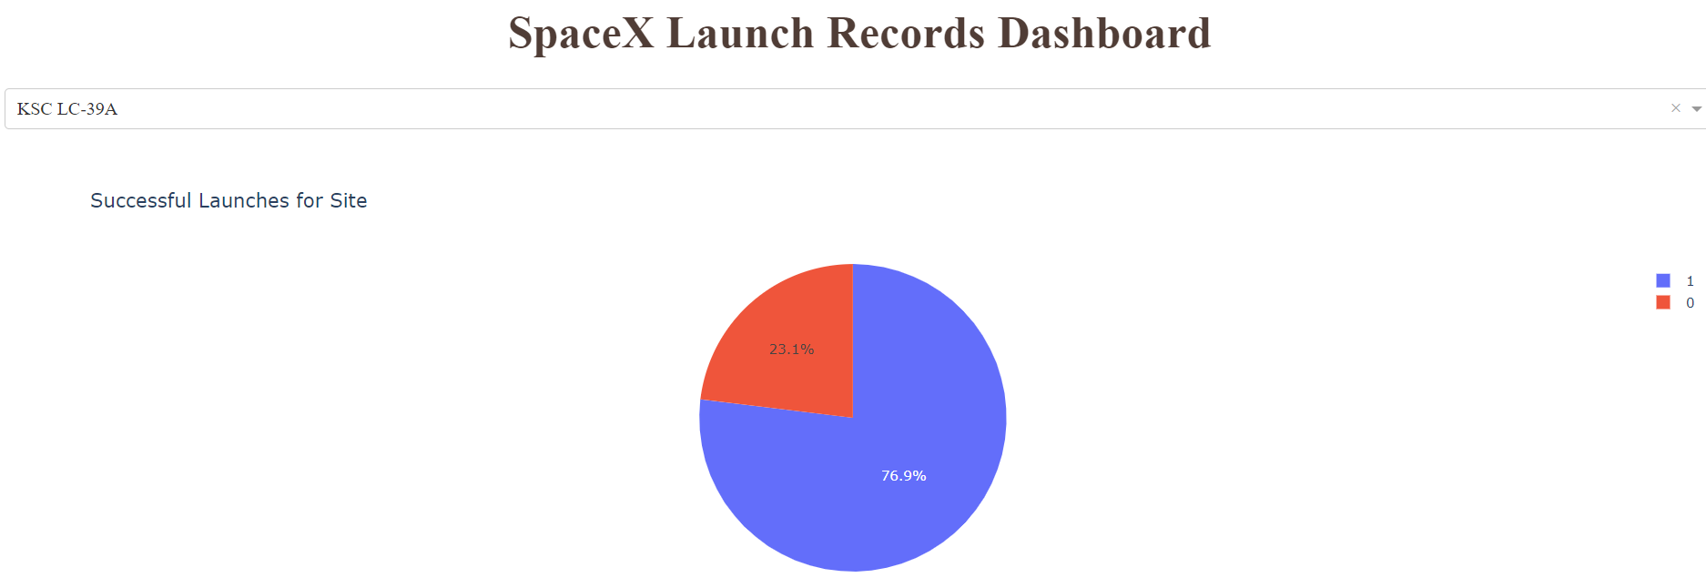
SpaceX Dash Application – Site with highest Success Rate
In the previous slide, where we showed ALL sites’ % Successes, we noted that you can select and individual site. Here, we show the screenshot of the piechart for the launch site with highest launch success ratio (KSC).
At KSC, launches were successful 76.9 % of the time.
Again, there is also a title (on the left) and a legend (on the right).

Slide 45
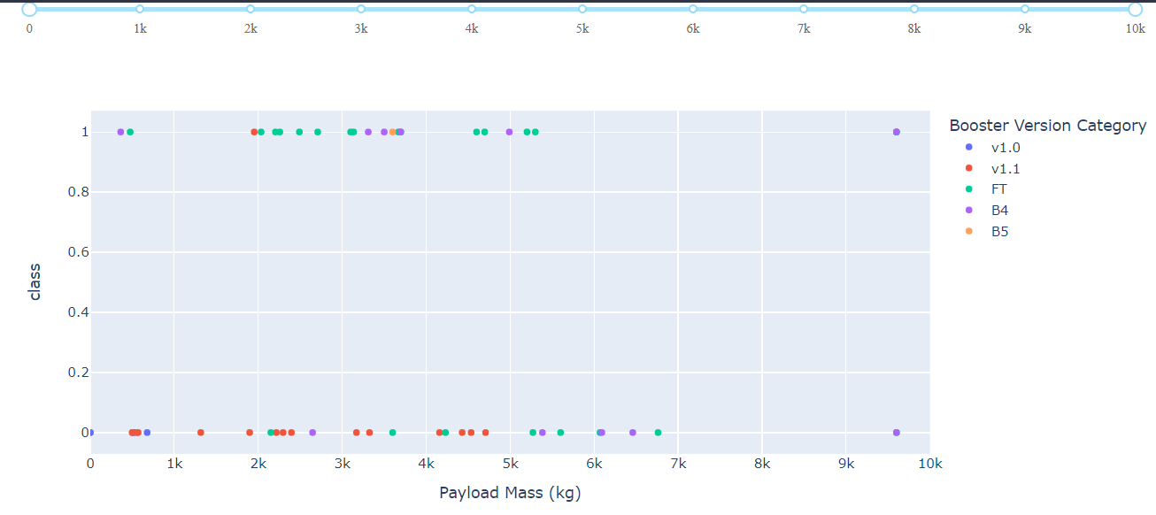
SpaceX Dash App – Booster Version Success at various payloads
This graph shows all Successes/Failures for all launches (1=Success, 0=Failure) with each Booster version color-coded as show in the legend on the right.
As you should see, only B4 and FT had successes beyond 5000 Kg weight; Version v1.1 had almost all failures; B5 was used only once (this could be because of the timing of the data collection.

Slide 46

Section 5

Slide 47
Classification Accuracy
A classification study was performed on the SpaceX launch data to determine predictive ability of various models to determine potential successes or failures using the categorical data.
Four models were created, per the process previously described. Fit accuracy describes how the model performed on the Training Data, whereas Model Accuracy describes how it performed on the Test data. The model that performed best was Decision Tree, with a Model Accuracy of 0.944 (or 94.4% of the time).

Slide 48
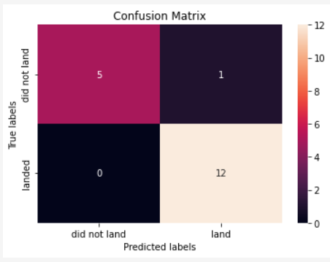
Confusion Matrix
The Confusion Matrix of the Decision Tree Model is shown below:
What this shows is that there were 12/18 that truly landed and 6/18 that did not land.
The model correctly predicted all 12 actual landings
The model should have predicted 6 non-landings, but only predicted 5. One was a false-positive, meaning that it predicted that launch should have landed, even though in reality it did not.

Slide 49
Conclusions
The decision tree model performed best on this data. But, like all predictive models, it will not always produce flawless results.
The other models performed well, but had a significant number of false-positives (approximately 50% of the failures were false-positives). They did, however, predict landings at a 100% correct rate.
Model building and evaluation are an iterative process and are highly sensitive to the quality of input data.
Data Scientists must continuously monitor their models and make adjustments as required.

Slide 50
Appendix
All relevant Jupyter Notebooks or Python Scripts were already linked in their corresponding slides and are easily accessible in my Github by following the links.
However, the Dash App Python script is linked here:
https://github.com/aristonacademy/CourseraCapstone/blob/main/spacex_dash_app%20(1).py
Please feel free to inquire about any other documents for which you wish a more detailed breakdown. Thank You.

Slide 51


